Slide 1
Stanislaus County Library
Special Collections Room
Genealogical Society of Stanislaus county, inc. project

Slide 2
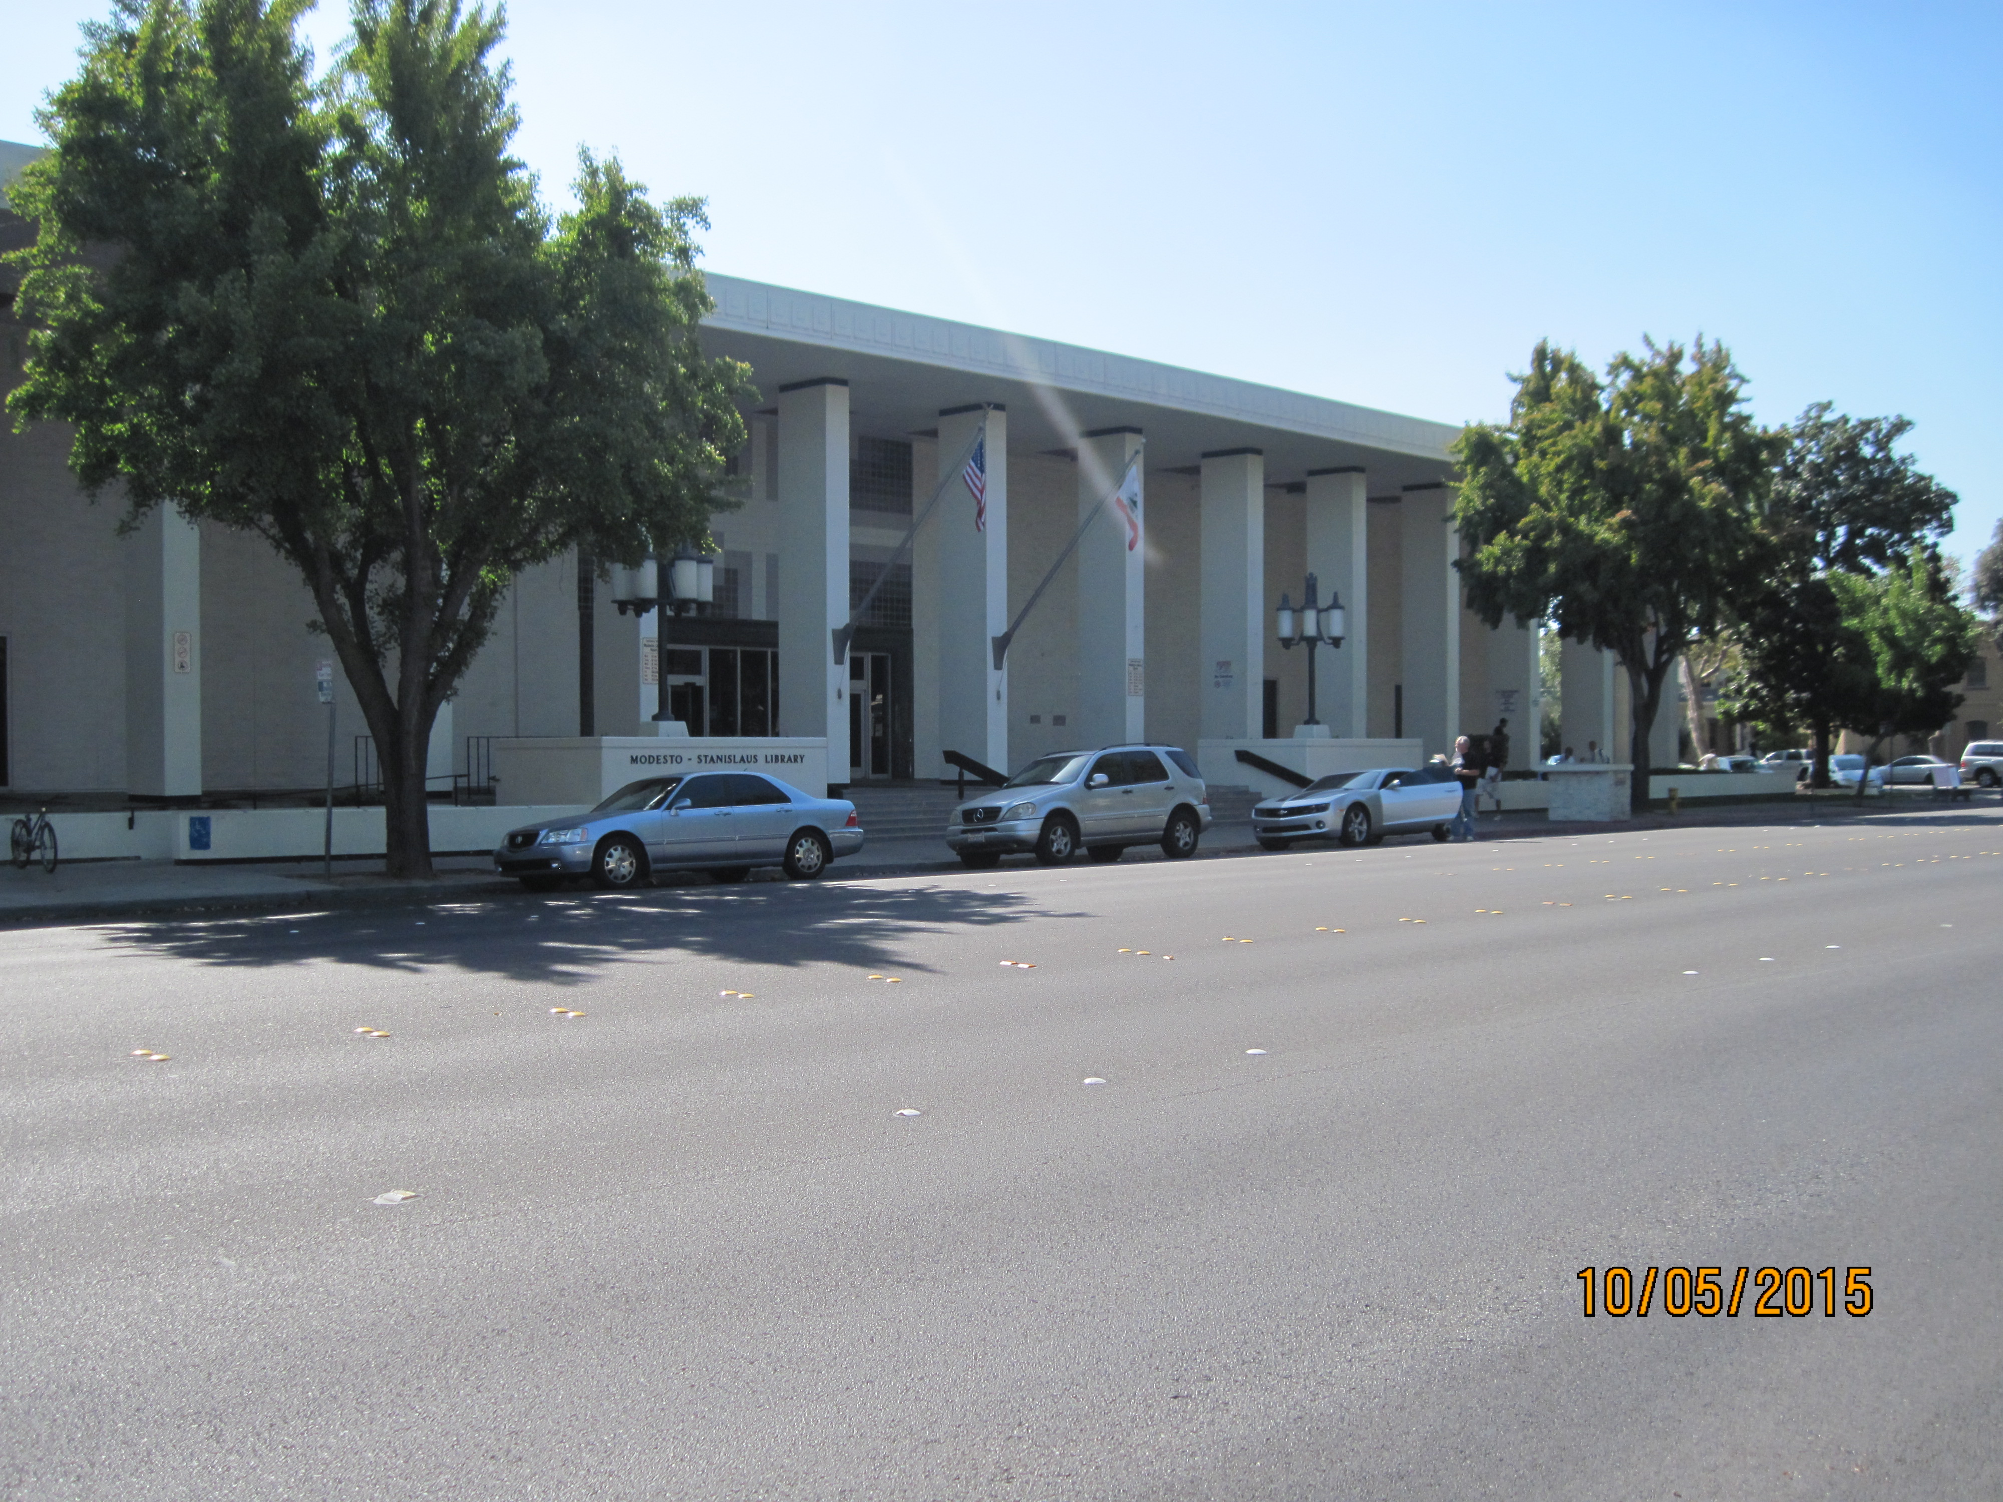

Slide 3
Address: 1500 I St, Modesto, CA 95354
Phone:(209) 558-7800
Hours:
Monday | 10:00 am – 9:00 pm
Tuesday | 10:00 am – 9:00 pm
Wednesday | 10:00 am – 9:00 pm
Thursday | 10:00 am – 9:00 pm
Friday | Closed
Saturday | 10:00 am – 5:00 pm
Sunday | Closed

Slide 4
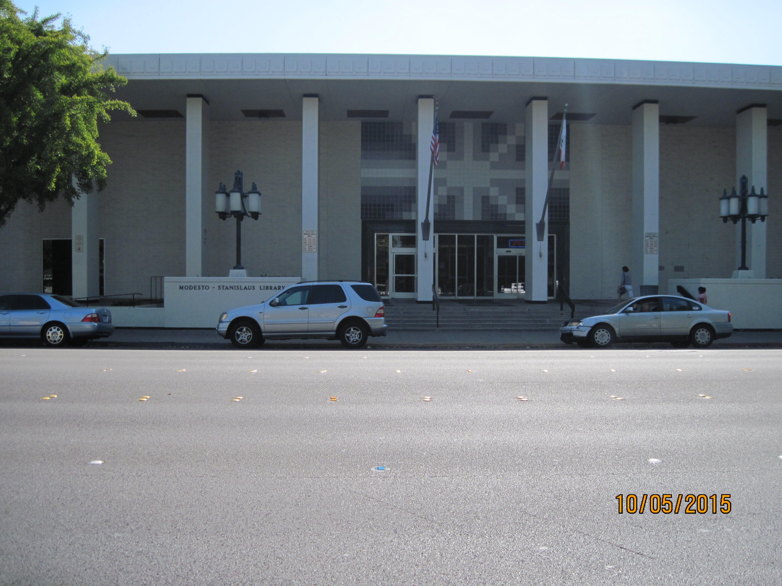

Slide 5
Usually there is more than ample parking in the lot on the south side of the building.

Slide 6
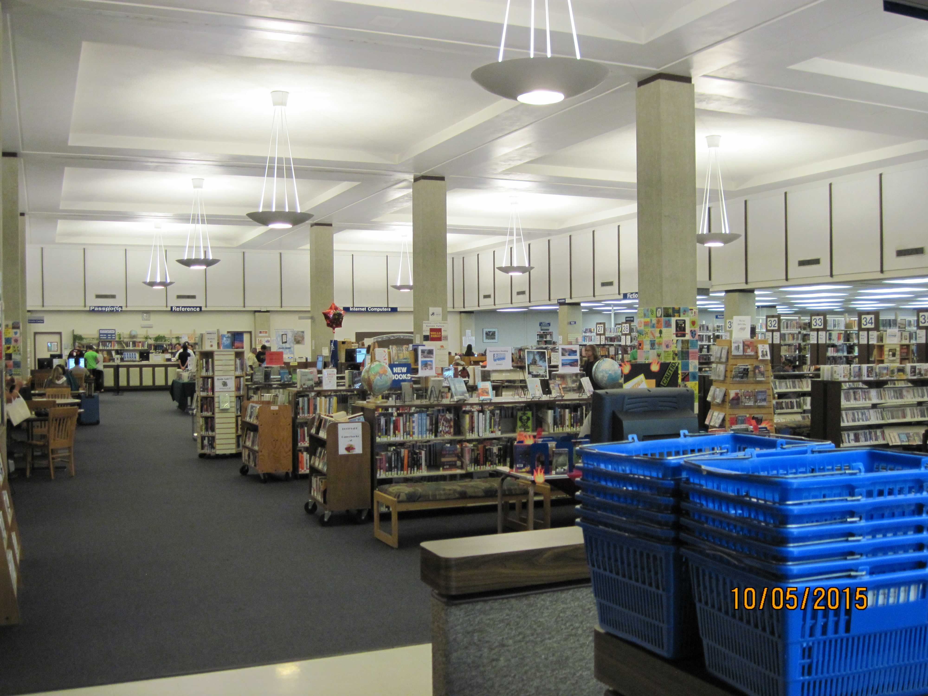

Slide 7
View of the interior at the left edge of the front desk.
Special Collections Room is in the back right to the right
of the Computer section. It will be closed and locked if
one of our GSSC volunteers is not present.
You will need to request admission at the Reference Desk.

Slide 8
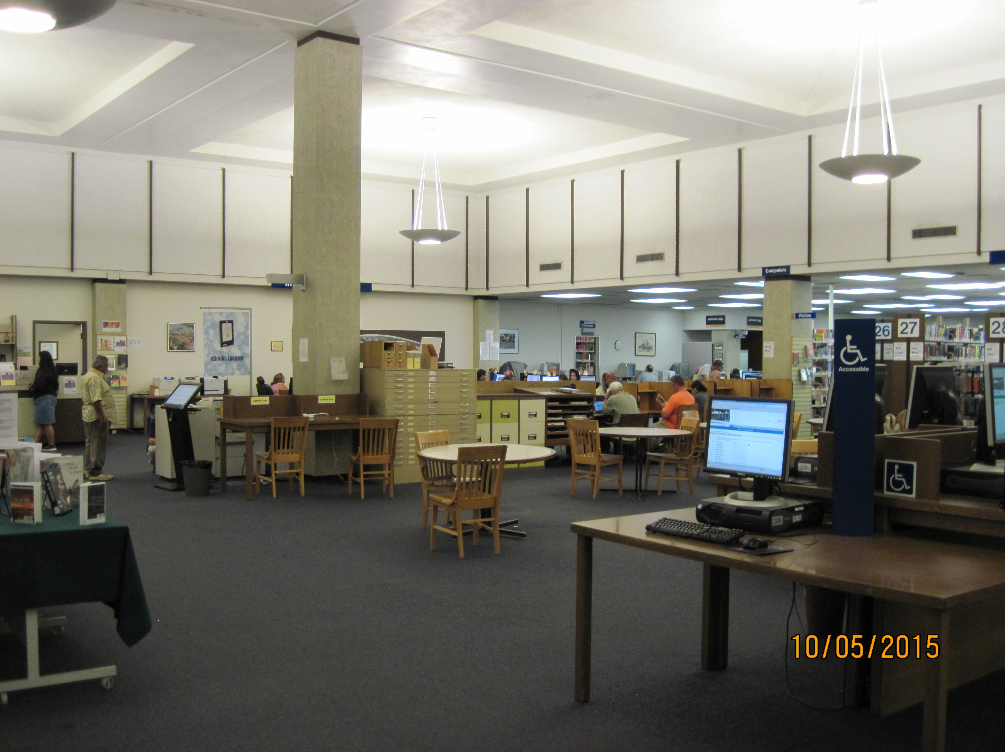

Slide 9
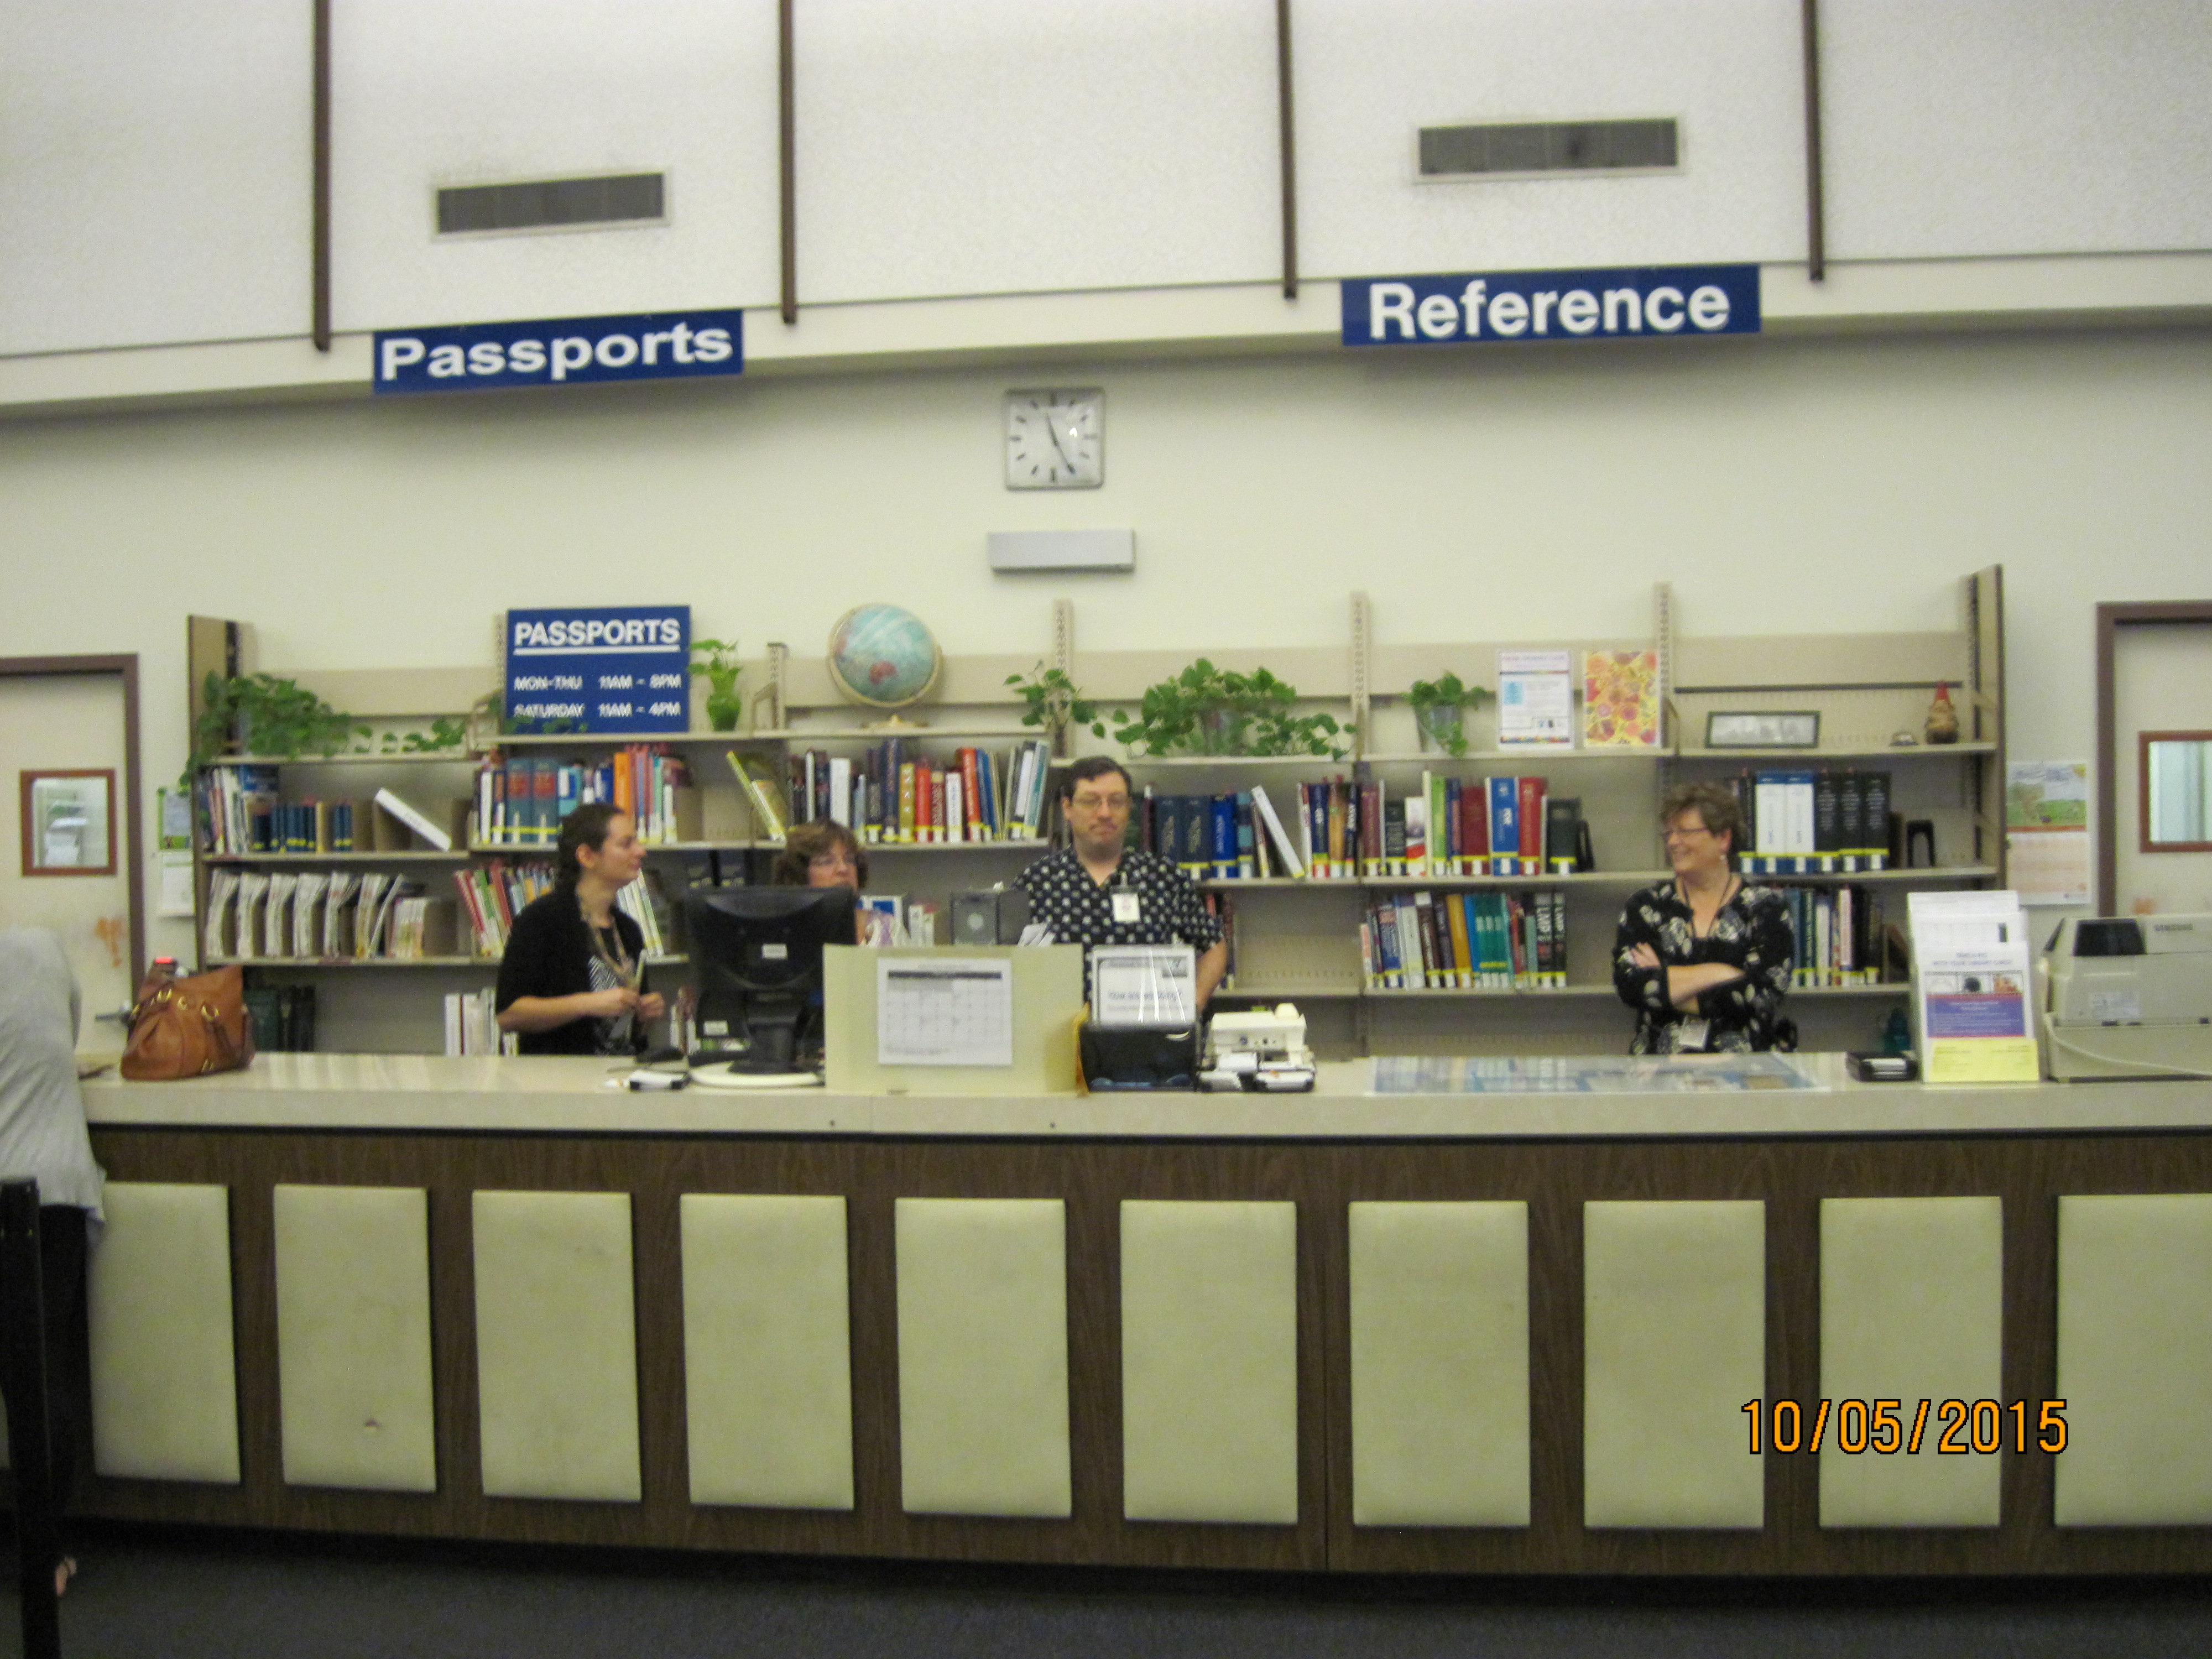

Slide 10
Go to the rear of the library to the Reference Desk and request admission
if our volunteer GSSC members are not present.
Also ask that the alcove room door within the Special Collections Room
be unlocked as well.

Slide 11
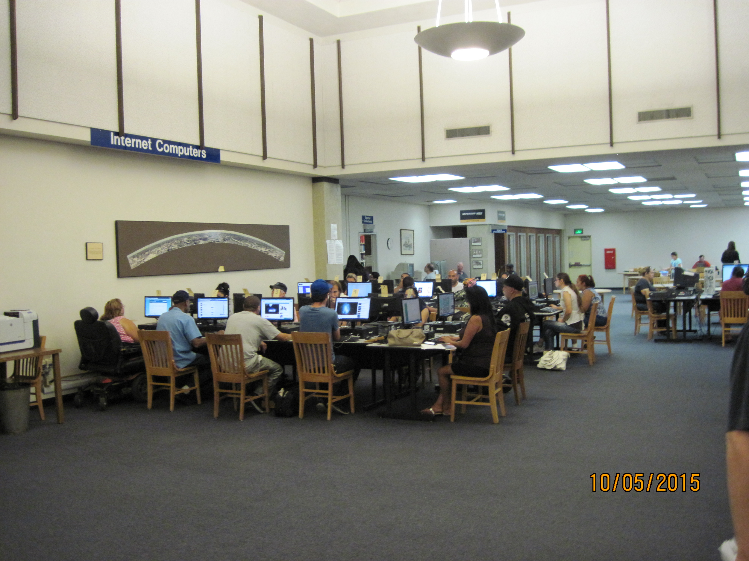

Slide 12
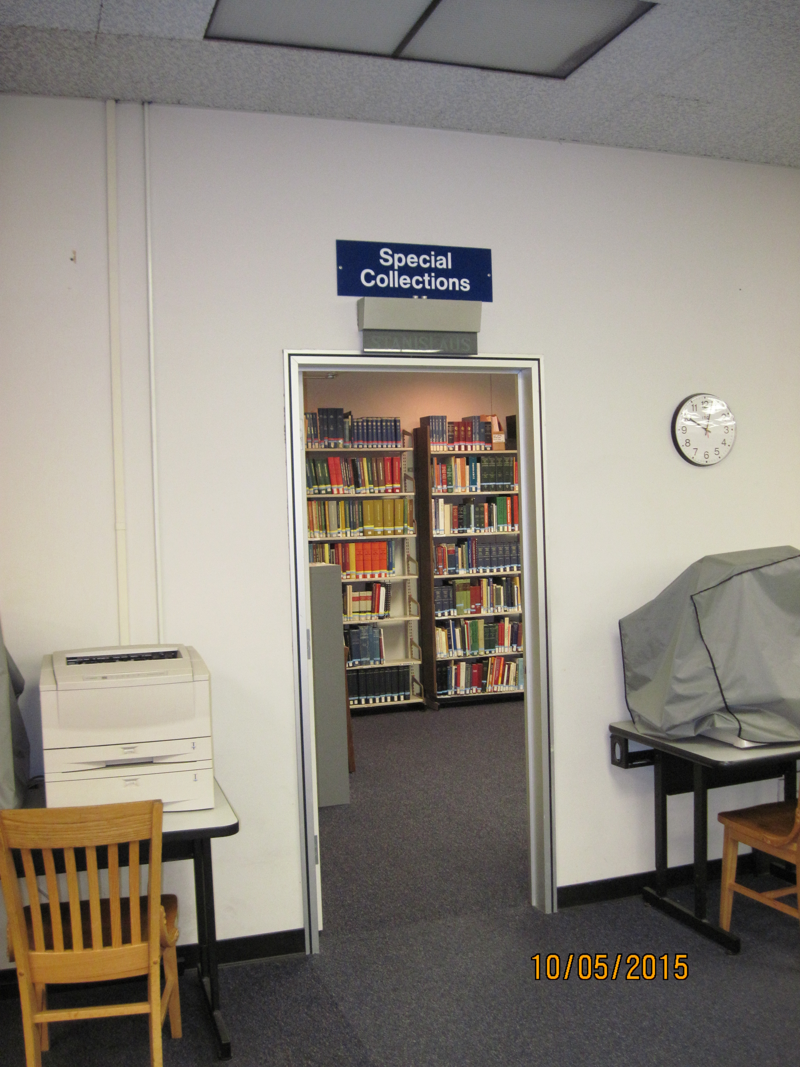

Slide 13
The Special Collections Room is staffed by our GSSC volunteers
every Monday from 10 A.M. to 3 P.M. unless the library is closed.
Upon special request we can have some one there to assist you.
Contact Marilyn Belleville (209) 523-8963 or via email m.belleville@att.net
She will make every effort to accommodate your needs.

Slide 14
Once admitted you will see a book cart in the middle of the room.
On top of the cart are two blue binders which hold a list of all of
the genealogical reference materials held here.
Taped to the end of the cart is a map with the Dewey decimal code
for each state found over the state. The shelves are arranged with
this standard library coding system.

Slide 15
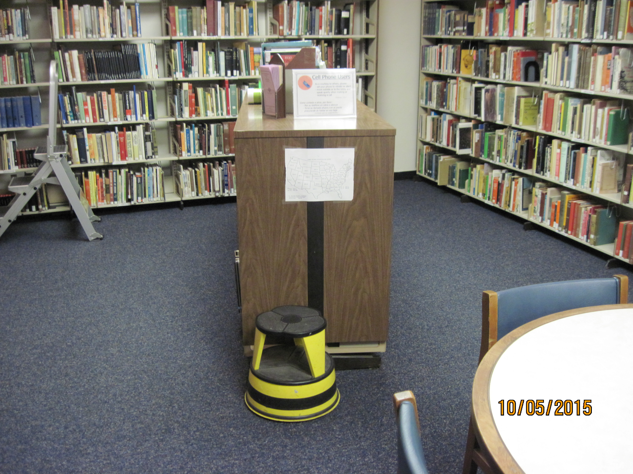

Slide 16
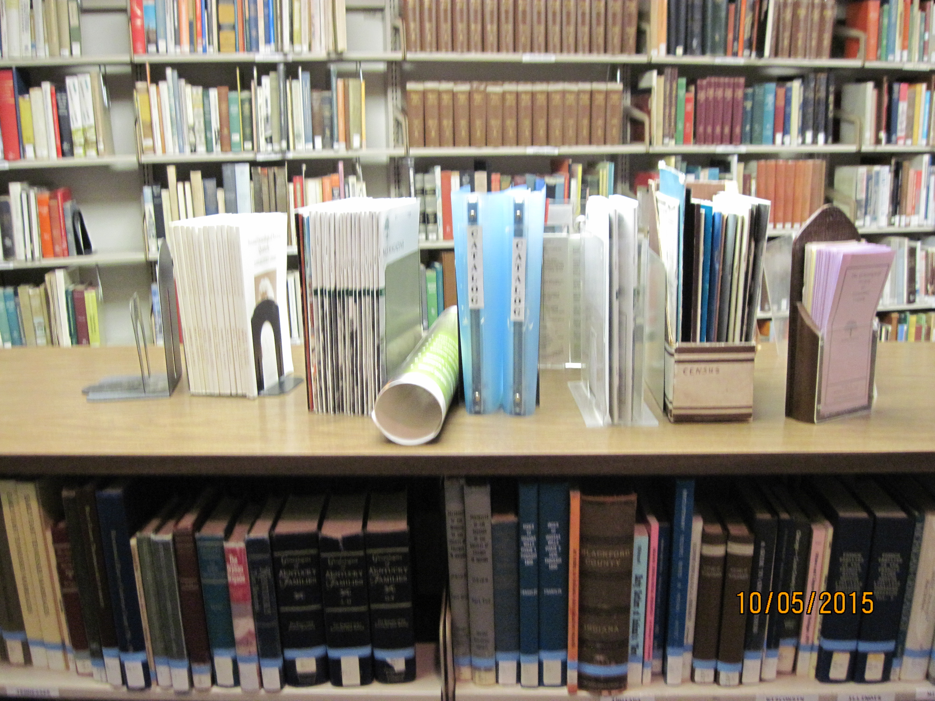

Slide 17
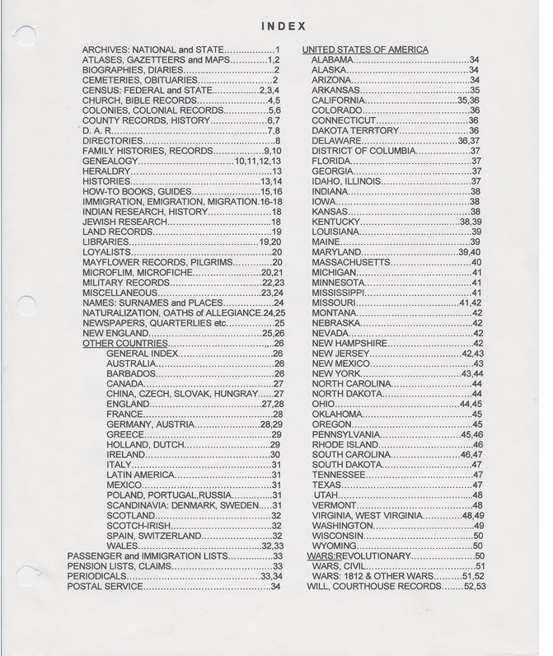

Slide 18
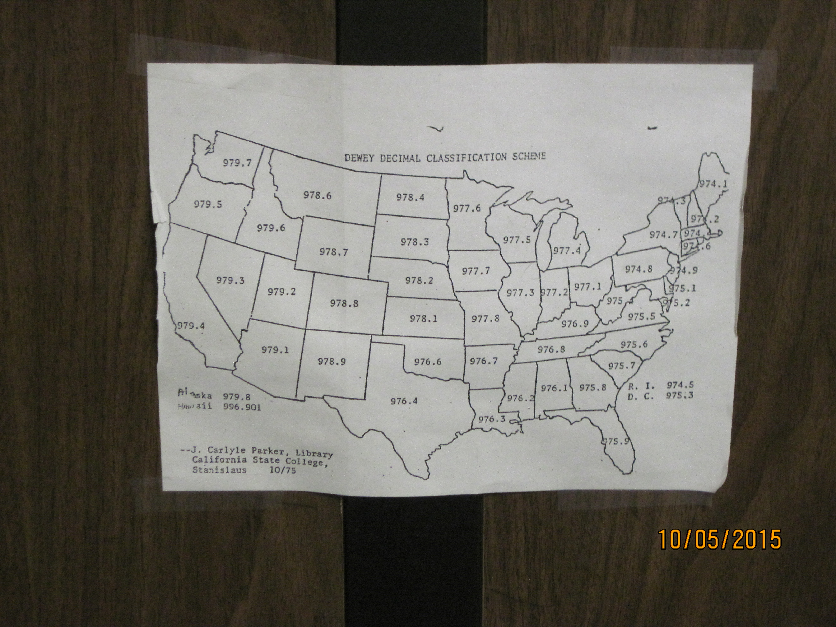

Slide 19
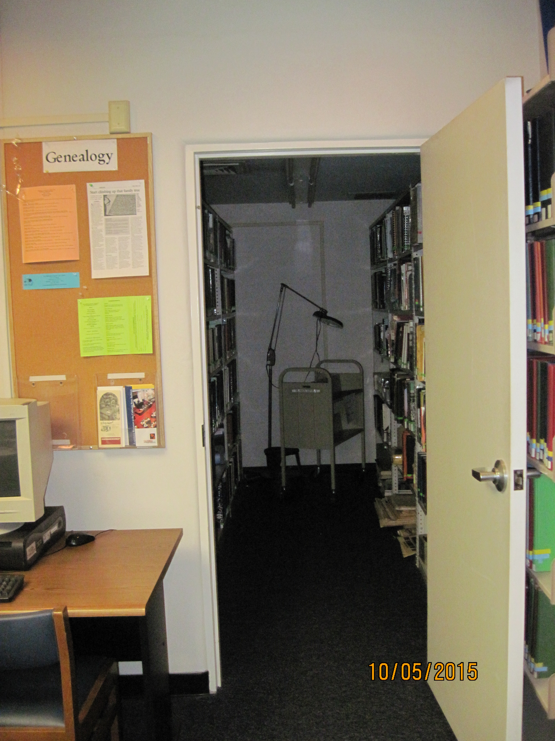

Slide 20
The Alcove holds Stanislaus County specific books and materials.
Books have green tape on the spine.

Slide 21
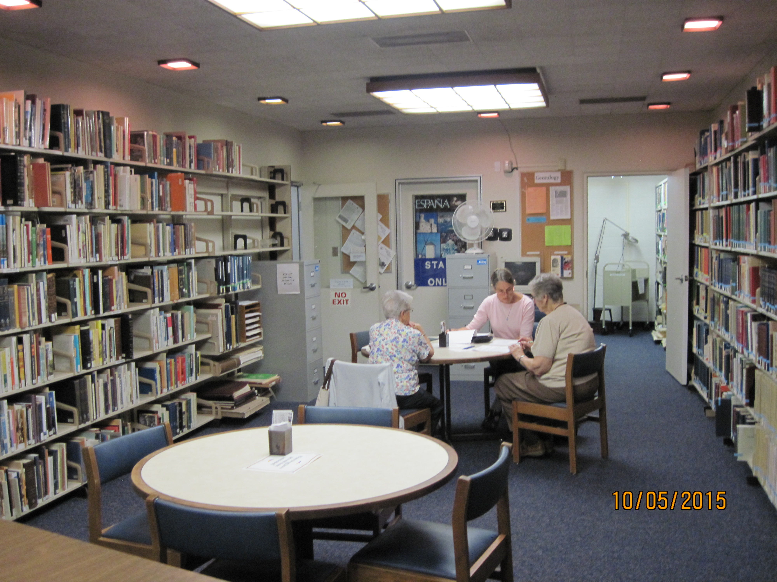

Slide 22
File cabinet against the east wall holds Stanislaus County information.
File cabinet against the north wall holds Modesto City information.

Slide 23
States Index on south wall just to the right of the Alcove room door.
Color coded with yellow and blue tape on the spine.
DAR books are on south wall.
Color coded with red and blue tape on the spine.
Family histories are coded with red dots and are on the south wall.
Heraldry books are found high on the south wall near the Alcove door.

Slide 24
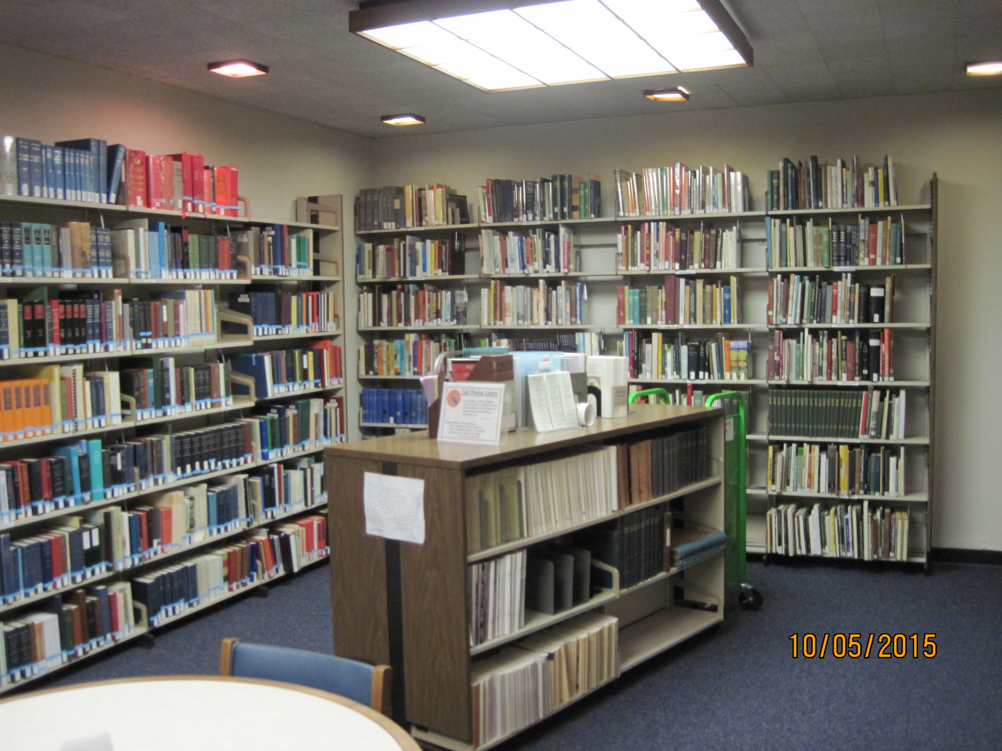

Slide 25
Stanislaus County Cemetery books are found on the north wall near the door.
They were created through a long term project of the GSSC and the copies here
are hard bound for their protection.

Slide 26
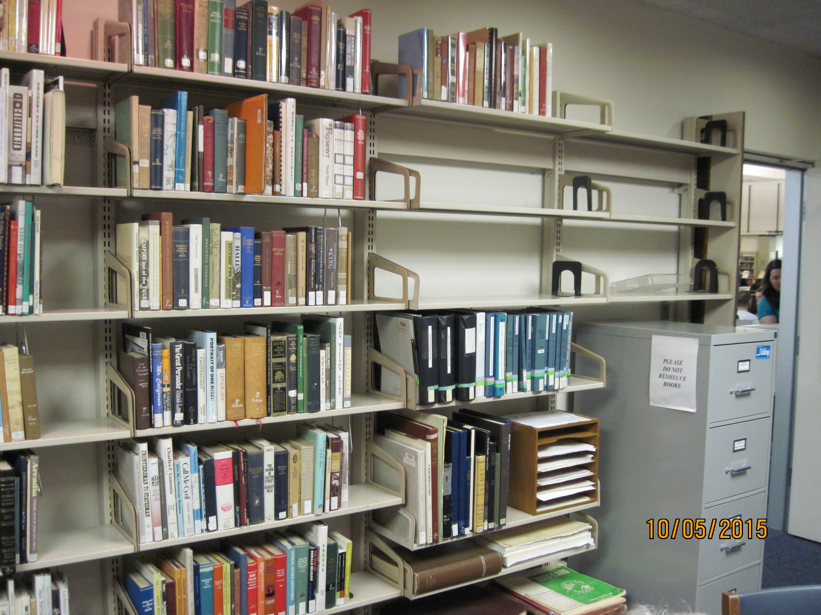

Slide 27
Remember our GSSC volunteers are present each Monday 10 AM to 3 PM
If you have a special need please contact Jackie Niemeyer (209) 522-2590
Jackie.Niemeyer@prodigy.net
This Resource has been created for your genealogical research.
Good hunting!

